Slide 1
An Introduction to Computer Programming for Experimental Research CNRI Fall 2023

Slide 2
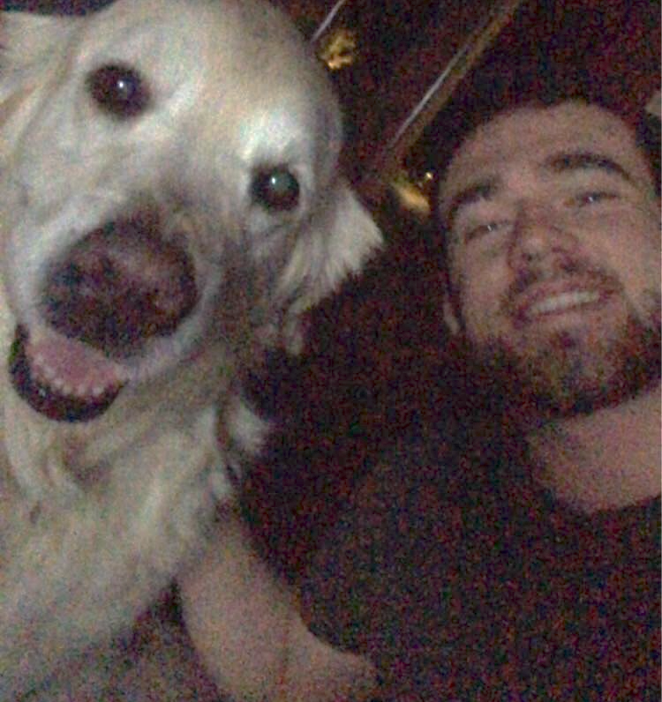
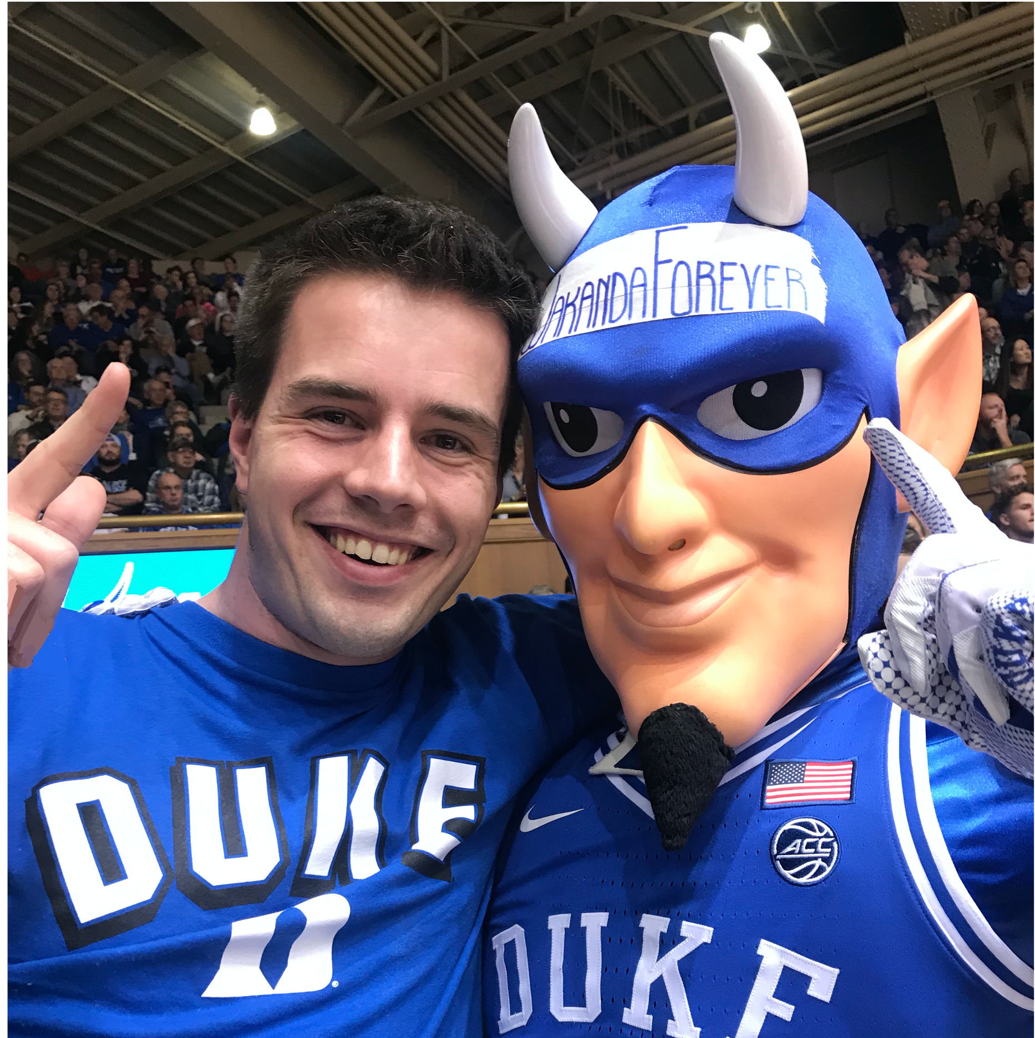

Instructors for this Class
Miles Martinez (he/him)
4nd year PhD student in Electrical & Computer Engineering, working with the Pearson and Mooney Labs
Raphael Geddert (he/him)
5rd year PhD student in Psychology & Neuroscience, working with the Egner and Pearson Labs

Slide 3
Class Overview

Slide 4
Class Organization
Lists and Loops
Libraries and Packages
Reading documentation
Building, Building, Building
Your First Experiment
Learning Python Basics
Stepping Outside Base Python
Building Behavioral Experiment
Data types, Booleans, Conditionality
Functions and Methods
PsychoPy, NumPy, and Pandas
Randomization and Counterbalancing
User Testing and Debugging

Slide 5
Class Organization
Your First Experiment
Group project -> approximately 2-3 people/group
Simple experiment that lets us focus on learning programming (not so much the research question of the experiment).
Lectures, examples, and homeworks will all provide help towards this goal
Notes:
Different from your typical computer science course, we will be focusing mainly on teaching you the elements and concepts of computer programming that best enable you to complete the semester goal of creating an experiment. This means that there will be concepts that we mention only briefly or in passing. We will try to touch address these concepts but mostly to get you familiar with the language and the extent to which it can be used.

Slide 6
Class Organization
In Class
Hybrid lecture-workshop class format
Introduce python concepts and practice applying them
Homework
Reinforce topics from class
Work on group projects
Occasionally downloading something for next week.

Slide 7
What does a psychology experiment involve?
How are experiments different from observational studies or surveys?

Slide 8
What does a psychology experiment involve?
Thought Problem:
Does drinking coffee prior to a visual search task lead to better (faster) performance?

Slide 9
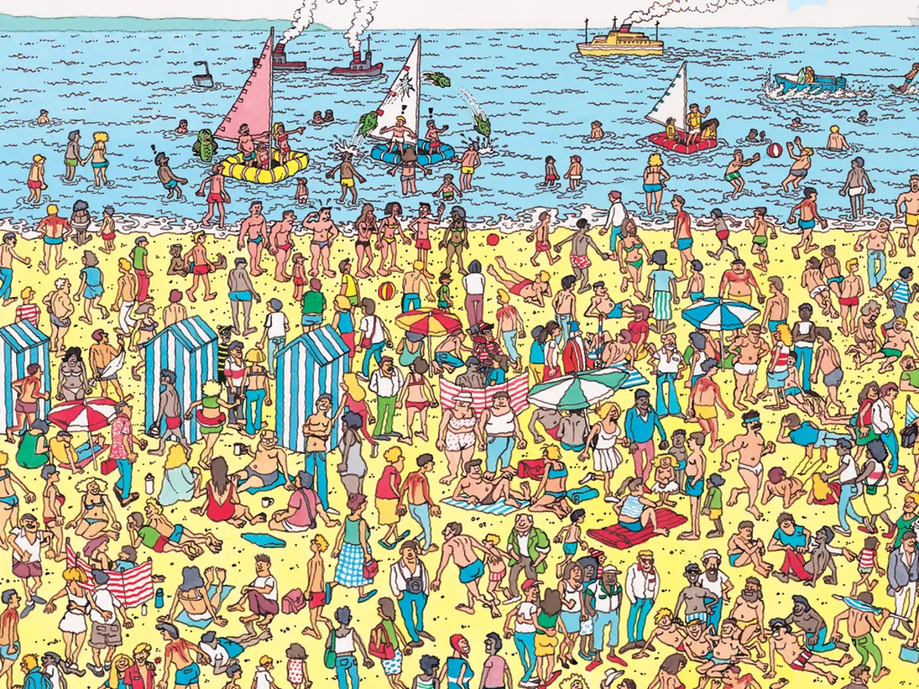
Where’s Waldo?

Slide 10
Create a pool of “Where’s Waldo” images want to show
Participants should all see the same set of images
What do we need for this experiment?
Show our images to our participant
Randomize which participants get coffee vs. napping
Record the choices our participants make and when
Judge whether participants performed well or not

Slide 11
Variables, data types
Create
Stimuli
Track
Progression
Counters, more loops
Randomize/
Counter-
balance
Display
Stimuli
Random number generators, functions
Libraries, Control Flow: loops, lists
Collect
Responses
Evaluate
Responses
Control Flow: Booleans, conditionality
Storing and saving data
** Not pictured: errors, debugging, testing, more errors, more debugging

Slide 12
Let’s get programming!
https://colab.research.google.com/

